Slide 1

API Management
Tomasso Groenendijk

Slide 2

Meet Tomasso Groenendijk
Live in the Netherlands
Senior Integration Consultant at Motion10
Azure MVP
Has over 15 years of experience in software development and software design

Slide 3
Overview
Introduction
Demo: Securing your API App with API Management
Questions

Slide 4








APIs and API economy
IoT
Mobile
“Application programming interfaces (APIs) have been elevated from a development technique to a business model driver and boardroom consideration…
APIs should be managed like a product - one built on top of a potentially complex technical footprint that includes legacy and third-party systems and data.
From the “API Economy”
by George Collins and David Sisk
Deloitte Consulting LLP, 2015
Hybrid IT
Cloud
Analytics
Microservices
“Integration is creation and consumption of APIs.”
-Vlad Vinogradsky
Notes:
Data and services fuel the APIs. APIs are essential for encapsulation and sharing information. Ever more complex business processes drive API usage inside businesses. Customers demand self-service and friction free interactions and transactions.
Mobile and other trends influence API usage across businesses. REST and cloud democratized API – simple and cheap to build and consume.
APIs long transcended high tech companies and are embraced by all verticals including finance, telco, media, and healthcare. For example, established banks are exploring becoming banking platforms to compete with PayPal, Stripe, Venmo, etc. Every auto maker is busily working on a telematics platform for their cars. Governments at every level adopt open API initiatives and make data and services available, e.g. 311, crime, etc.
Agility and innovation are ever more important due to increased competition and disruption. Loosely coupled APIs are the technical foundation – microservices.
All traditional enterprise integration vendors are pursuing API-centric approach which pivots around exposing data internally and externally rather than connecting application together.

Slide 5
APIs as products
How do you project your legacy backend API?
How do you protect your core business systems?
How do you enforce your IT and business policies?
How do you engage with developers?
How do you make using your APIs quick and easy?
How do you measure their use and impact?
API Management
Notes:
When you have a single or a few APIs and as many consumers you may punt on some of these and implement others in the backends, but that won’t scale. Enter API Management.

Slide 6

Azure API Management
API consumers
AZURE API MANAGEMENT
Abstraction
decouple
modernize
optimize
...
Middleware
secure
protect
cache
...
Monitoring
usage
health
monetization
...
Developer
discover
document
on-board
...
APIs on Azure
Azure APIs
On-prem APIs
3rd party APIs
Notes:
There is a saying that any problem in software engineering can be solved by adding a level of indirection (or abstraction). Abstraction has its costs to be sure, but benefits usually are much greater. APIM creates a public facade over your APIs and decouples API implementations or backends from API consumers enabling them to evolve independently. This includes hiding all APIs regardless of their location behind a single domain name and API address. Exposing only a subset of backend capabilities to API consumers. Modernizing and normalizing APIs by changing their URL structure and response formats. Optimizing APIs for specific consumers and scenarios by conditionally stripping down the responses. Dynamically routing requests to implement advanced versioning approaches
Second, APIM allows API implementers to externalize and centralize common cross cutting concerns and focus on the core value, the domain related logic. Security, throttling, cross domain access and response caching are just a few horizontal capabilities you'll get from APIM. APIM supports API key, JWT token validation as well as IP based authorization. We offer a number of cross domain techniques including full support for CORS. APIM implements distributed quota and rate limiting policies that allow a great degree of flexibility and scale. It comes with built in response cache and policies that allow fine grained control over what and how gets cached
Having insight into usage and health of your APIs is important and APIM captures metrics and provides key reports out of the box. For those customers who are looking to monetize their APIs we collect and offer via API data allowing them to implement a variety of subscription business models.
With APIM Developer portal you can treat internal and external developers the same way from the get go and provide them with a self service on-boarding experience, AP catalog, documentation, samples, and allow them to send request to your APIs without writing a line of code.
■ Know who API users are and engage them like customers. Whether the developers programming to one’s APIs are inside the organization or outside, knowing who they are is a foundation of API success. For an API provider that charges for API use, like Twilio and SendGrid, this is of course necessary for collecting revenue, but even for free access, as with New York’s and Chicago’s transit systems’ APIs, knowing API users enables greater understanding of how APIs are used and what direction to take APIs in the future. API users, whether they pay or not, should be engaged as customers.
■ Clarify the rules of API access. For reasons of capacity management and security, access to APIs is rarely unlimited. But customers (i.e., API users in this case) don’t like surprises, so the
rules for access must be clear, such as what data may be accessed and how many requests are allowed per minute or per month. is may include de nition of di erent access plans with di erent rules for di erent API users.
Make it easy to use the API. rough documentation, examples, and discussion forums, it must be easy for API users to understand the API, get answers to questions, test API usage, and migrate between API versions. Although REST services are needed for mobile, other styles of services may also be part of an enterprise API strategy (e.g., SOAP, message queuing).
Enforce the rules of API access. API providers must validate that incoming API requests are authorized and comply with the rules de ned by the access plan each API user is associated with.
Proactively manage API success by treating it as a product. Whether API users are internal, external, or both, to optimize the business value of an API, the API provider must treat it as a product with customers and a life cycle. Whether via basic reporting or advanced analytics, API providers must understand patterns of API access, including error rates that may indicate the
API is di cult to understand. New versions of the API need a smooth and managed rollout to API users.
■ Connect API access to functions and data within their technology estate. APIs deliver their value by connecting to the API provider’s data and applications. Some of these assets may be API- ready, while others may need some manner of integration connectivity to make them accessible.

Slide 7

AZURE API
MANAGEMENT
APP DEVELOPERS
Developer Portal
Gateway
API App
APPS
Publisher portal
API PUBLISHERS

Slide 8
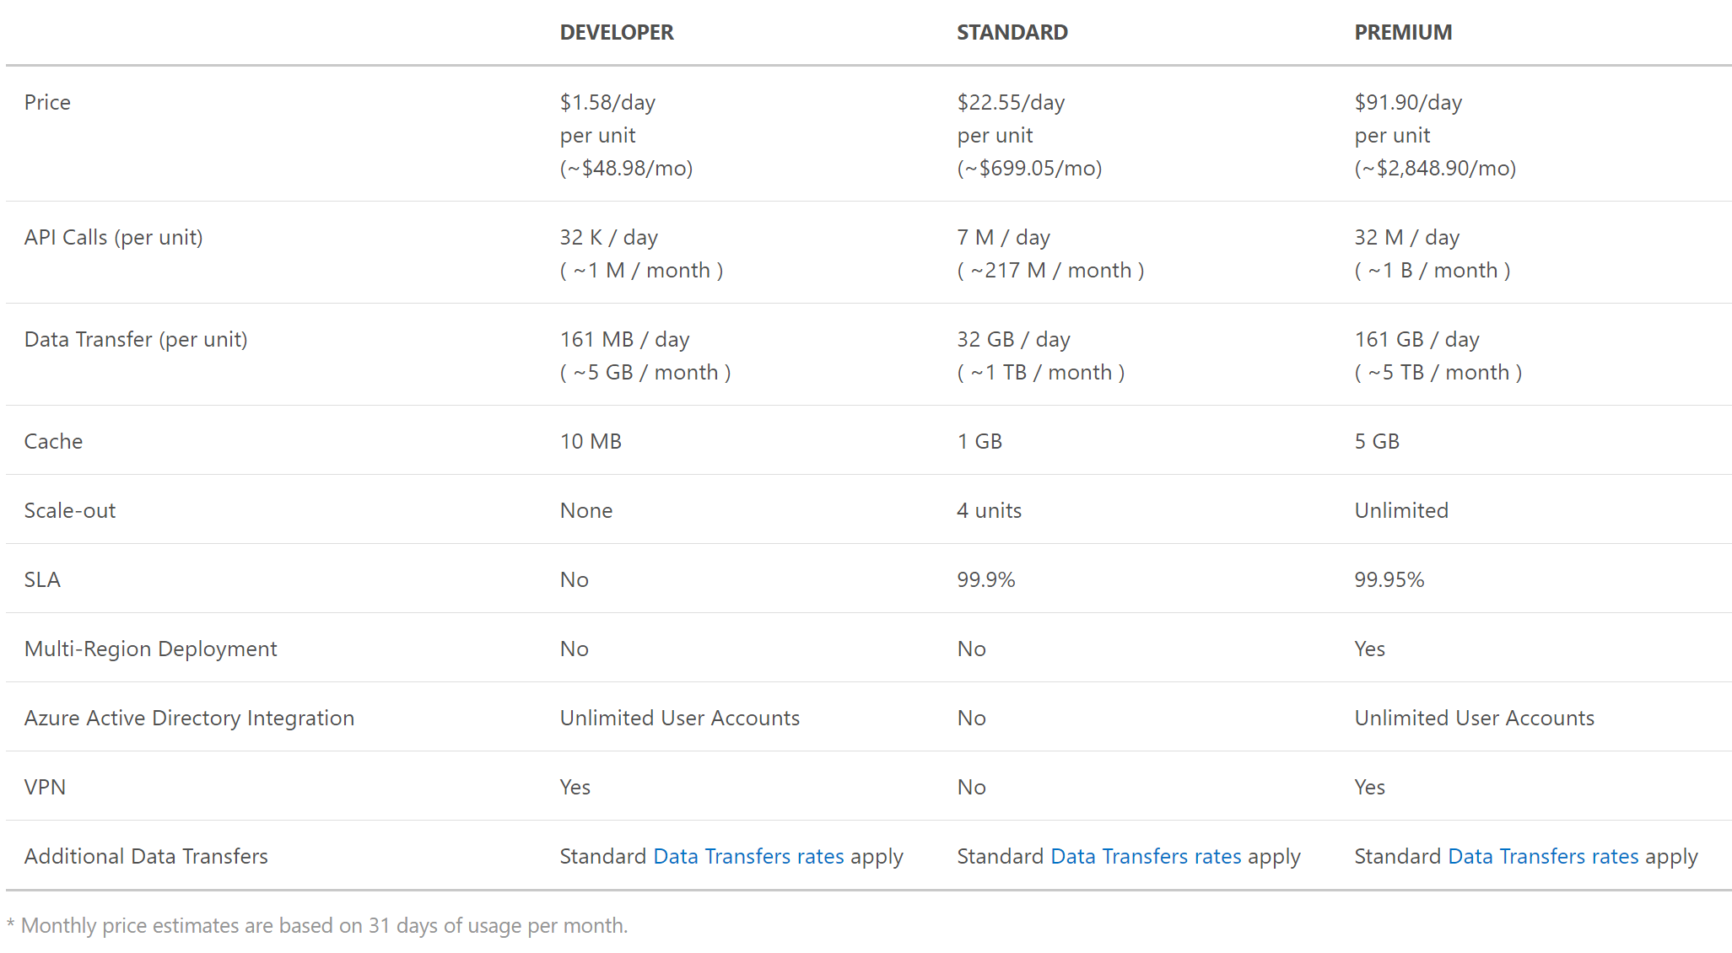
Pricing

Slide 9


Securing your API App with API Management
Demo
Requests
API Management
API App
Add a new API to API Management
Add API to the product
Policies
Developer Portal

Slide 10



Questions?
twitter.com/tlagroenendijk
linkedin.com/in/tomassogroenendijk
www.ithero.nl

